Slide 1
JUnit course
25/10/2023 – Cristian Bulgarelli

Slide 2

1. Introduction
Software requires testing before being deployed into production.
Test automation brings a number of benefits, including:
- automatic test execution at each project build (maven)
- greater speed and reliability of tests
- check to avoid regressions
- prevents bugs
Cristian Bulgarelli - the source code is available at https://overit-factory@dev.azure.com/overit-factory/academy/_git/junitcourse

Slide 3
2. JUnit Overview
JUnit 5 = JUnit Platform + JUnit Jupiter + JUnit Vintage
The JUnit Platform serves as a foundation for launching testing frameworks on the JVM.
JUnit Jupiter is the combination of the programming model and extension model for writing tests and extensions in JUnit 5.
JUnit Vintage provides a TestEngine for running JUnit 3 and JUnit 4 based tests on the platform. It requires JUnit 4.12 or later to be present on the class path or module path.
JUnit 5 requires Java 8 (or higher) at runtime. However, you can still test code that has been compiled with previous versions of the JDK.
Cristian Bulgarelli - the source code is available at https://overit-factory@dev.azure.com/overit-factory/academy/_git/junitcourse

Slide 4
3. Getting Started with Junit (https://junit.org/junit5/)
Setting up JUnit 5.x.0 is pretty straightforward; we just need to add the following dependency to our pom.xml:
<dependency>
<groupId>org.junit.jupiter</groupId>
<artifactId>junit-jupiter-engine</artifactId>
<version>5.10.0</version>
<scope>test</scope>
</dependency>
<build>
<plugins>
[...]
<plugin>
<groupId>org.apache.maven.plugins</groupId>
<artifactId>maven-surefire-plugin</artifactId>
<version>3.1.2</version>
[... configuration or goals and executions ...]
</plugin>
[...]
</plugins>
</build>
To run the junits present in the project, the use of the maven surefire plugin is required. This plugin is automatically available in a maven project, so there's no need to configure it. Anyway, here's an example of including it in a pom.xml:
Cristian Bulgarelli - the source code is available at https://overit-factory@dev.azure.com/overit-factory/academy/_git/junitcourse

Slide 5
Writing and running your first JUnit test
Suppose we have the following class to test:
package com.overit.junitcourse.example1;
public interface MessageUtil {
String HELLO = "Hello ";
String getHelloMessage(String name);
}
package com.overit.junitcourse.example1;
public class MessageUtilImpl implements MessageUtil {
@Override
public String getHelloMessage(String name) {
return HELLO + name;
}
}
implementation
How do we test it? Let's create a class with the same name, followed by the Test suffix:
com.overit.junitcourse.example1.MessageUtilImplTest.
This class must be created within the project, in the src/test path, in the same package as the class to be tested.
Cristian Bulgarelli - the source code is available at https://overit-factory@dev.azure.com/overit-factory/academy/_git/junitcourse

Slide 6
package com.overit.junitcourse.example1;
import org.junit.jupiter.api.BeforeEach;
import org.junit.jupiter.api.Test;
import static org.junit.jupiter.api.Assertions.assertEquals;
class MessageUtilImplTest {
private MessageUtil sut;
@BeforeEach
void setUp() {
sut = new MessageUtilImpl();
}
@Test
void getHelloMessage_WithNotNullName_ReturnsExpectedHelloMessage() {
// given
String name = "JUnit world";
// when
String actual = sut.getHelloMessage(name);
// then
assertEquals(MessageUtilImpl.HELLO + name, actual);
}
}
General consideration:
the created class has package-private visibility
(introduced with Jupiter)
typically the class under test will be referenced via a
member variable whose name is the acronym sut,
subject under test
Cristian Bulgarelli - the source code is available at https://overit-factory@dev.azure.com/overit-factory/academy/_git/junitcourse

Slide 7
package com.overit.junitcourse.example1;
import org.junit.jupiter.api.BeforeEach;
import org.junit.jupiter.api.Test;
import static org.junit.jupiter.api.Assertions.assertEquals;
class MessageUtilImplTest {
private MessageUtil sut;
@BeforeEach
void setUp() {
sut = new MessageUtilImpl();
}
@Test
void getHelloMessage_WithNotNullName_ReturnsExpectedHelloMessage() {
// given
String name = "JUnit world";
// when
String actual = sut.getHelloMessage(name);
// then
assertEquals(MessageUtilImpl.HELLO + name, actual);
}
}
Introducing the @Test annotation
Test Method Considerations:
each test method is decorated with the
org.junit.jupiter.api.Test annotation (@Test)
each test method has package-private visibility
(new introduced with Jupiter)
each test method follows the following naming
convention:
<method under test>_<tested scenario>_<expected result>
Cristian Bulgarelli - the source code is available at https://overit-factory@dev.azure.com/overit-factory/academy/_git/junitcourse

Slide 8
package com.overit.junitcourse.example1;
import org.junit.jupiter.api.BeforeEach;
import org.junit.jupiter.api.Test;
import static org.junit.jupiter.api.Assertions.assertEquals;
class MessageUtilImplTest {
private MessageUtil sut;
@BeforeEach
void setUp() {
sut = new MessageUtilImpl();
}
@Test
void getHelloMessage_WithNotNullName_ReturnsExpectedHelloMessage() {
// given
String name = "JUnit world";
// when
String actual = sut.getHelloMessage(name);
// then
assertEquals(MessageUtilImpl.HELLO + name, actual);
}
}
each test method is divided into three sections:
given: section in which the preliminary operations for the execution of the method under test are carried out
when: section in which the method under test is invoked (if the method includes a return value, it is stored in a variable with the name actual)
then: section in which assertions are made relating to the expected result of the test
Cristian Bulgarelli - the source code is available at https://overit-factory@dev.azure.com/overit-factory/academy/_git/junitcourse

Slide 9
The naming convention on the method name often generated test methods with very long names. To overcome this inconvenience, Jupiter has introduced a new annotation: @DisplayName. Here is an example of use:
…
@Test
@DisplayName("getHelloMessage: when invoked with a not null name, a formatted hello message is expected")
void getHelloMessage_WithNotNullName_ReturnsExpectedHelloMessage() {
// given
String name = "JUnit world";
// when
String actual = sut.getHelloMessage(name);
// then
assertEquals(MessageUtilImpl.HELLO + name, actual);
}
…
Cristian Bulgarelli - the source code is available at https://overit-factory@dev.azure.com/overit-factory/academy/_git/junitcourse

Slide 10
4. Assertions and Test Fixtures
Understanding JUnit assertions.
JUnit assertions are useful for encoding expected behavior and considered successful behavior which, if achieved, classifies the test as successful.
The developer has the possibility to make all the assertions he deems necessary to best describe the expected behavior of the test.
If within a test, at least one assertion is not respected, then the entire test will be considered failed.
Cristian Bulgarelli - the source code is available at https://overit-factory@dev.azure.com/overit-factory/academy/_git/junitcourse

Slide 11
Creating test fixtures with @BeforeEach, @AfterEach, @BeforeAll, @AfterAll
In a test class, all test methods are executed completely independently of each other, and in a random order.
JUnit provides annotations useful for decorating methods containing code to be executed before or after tests.
@BeforeEach: is used to signal that the annotated method should be executed before each @Test in the current test class
@AfterEach: is used to signal that the annotated method should be executed after each @Test in the current test class
@BeforeAll: is used to signal that the annotated static method should be executed before all tests in the current test class, only once
@AfterAll: is used to signal that the annotated static method should be executed after all tests in the current test class, only once
Cristian Bulgarelli - the source code is available at https://overit-factory@dev.azure.com/overit-factory/academy/_git/junitcourse

Slide 12
5. AssertJ (https://assertj.github.io/doc/#assertj-core-assertions-guide)
The AssertJ dependency has been widely used, which allows you to make assertions in a more fluent way than JUnit, concatenating them in a very simple way. In order to use this dependency, you will need to integrate it as follows within your project's pom.xml:
<dependency>
<groupId>org.assertj</groupId>
<artifactId>assertj-core</artifactId>
<version>3.24.2</version>
<scope>test</scope>
</dependency>
@Test
void getHelloMessage_WithNotNullNameAndAssertJ_ReturnsExpectedHelloMessage() {
// given
String name = "JUnit world";
// when
String actual = sut.getHelloMessage(name);
// then
assertThat(actual).isNotNull().isEqualTo(MessageUtilImpl.HELLO + name);
}
Here's an example of how you can use it in place of Junit's common assertions (all assertions are static methods in org.assertj.core.api.Assertions class):
Cristian Bulgarelli - the source code is available at https://overit-factory@dev.azure.com/overit-factory/academy/_git/junitcourse

Slide 13
With AssertJ it is easy to make complex assertions, such as the following, in which we check that a certain result is a collection with a certain size, and that it contains, in any order, a complete list of elements, compared using the values of their instance variables.
....
// then
assertThat(actual).isNotNull()
.isNotEmpty()
.hasSize(2)
.usingRecursiveFieldByFieldElementComparator() // recursive field by field comparison strategy
.containsExactlyInAnyOrder(expectedMarioRossi, expectedCarloBianchi);
Cristian Bulgarelli - the source code is available at https://overit-factory@dev.azure.com/overit-factory/academy/_git/junitcourse

Slide 14
Assertions about exceptions
You can also verify that the method under consideration raises a certain exception.
In the following example, the called method is asserted to raise a NoUsersFoundException with the message NO_USERS_WERE_FOUND_BY_APPLYING_THE_REQUESTED_FILTER.
Here’s an example using Junit assertions:
....
// when - then
assertThrows(NoUsersFoundException.class, () -> sut.filterByGender(gender, users), NO_USERS_WERE_FOUND_BY_APPLYING_THE_REQUESTED_FILTER);
And here’s another example using AssertJ assertions:
....
// when - then
assertThatThrownBy(() -> sut.filterByGender(gender, users))
.isInstanceOf(NoUsersFoundException.class)
.hasMessage(NO_USERS_WERE_FOUND_BY_APPLYING_THE_REQUESTED_FILTER);
Cristian Bulgarelli - the source code is available at https://overit-factory@dev.azure.com/overit-factory/academy/_git/junitcourse

Slide 15
Review the test results from the terminal
After developing JUnit tests in a Java project, you can compile that project and run the tests using the following maven command: (or, as mentioned, the maven mvn clean install command will also run the tests).
mvn clean test
Where there is even one failed test, the entire build will fail.
To be able to compile the code without running the tests, you can run the following command:
mvn clean install -DskipTests
Cristian Bulgarelli - the source code is available at https://overit-factory@dev.azure.com/overit-factory/academy/_git/junitcourse

Slide 16
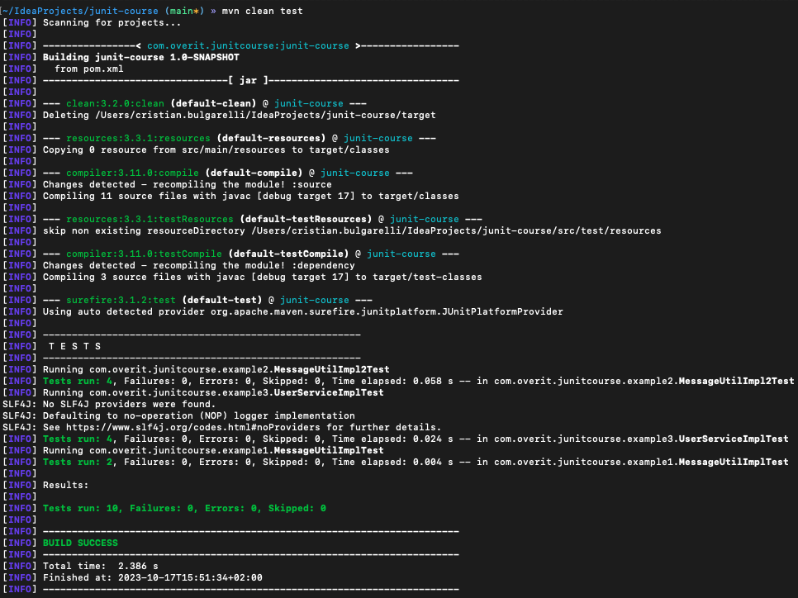
Here is an example of a test compilation launched from the terminal and completed successfully:
Cristian Bulgarelli - the source code is available at https://overit-factory@dev.azure.com/overit-factory/academy/_git/junitcourse

Slide 17
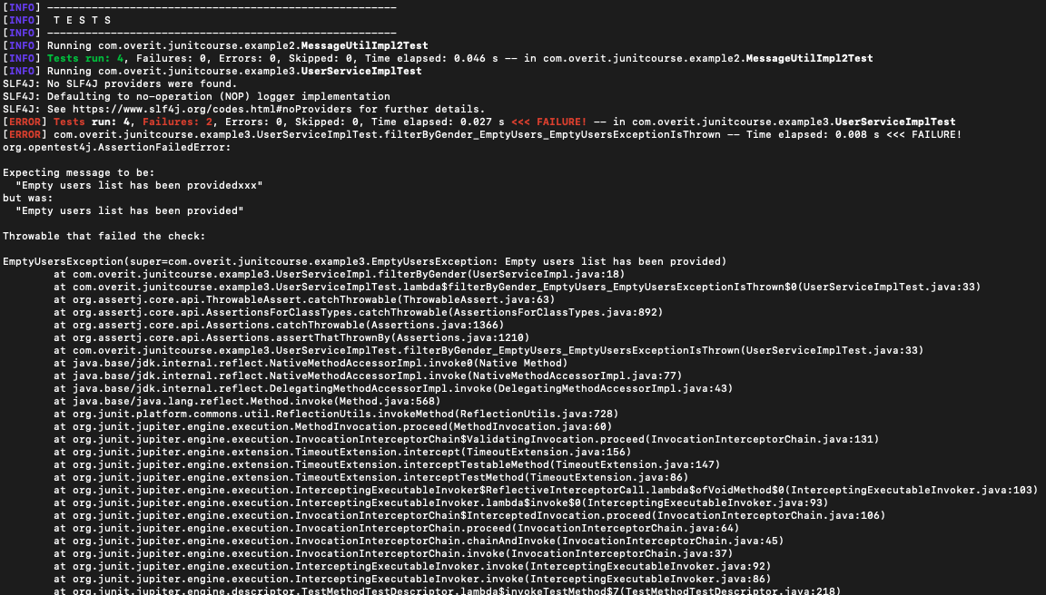
Here is another example of a test compilation launched from the terminal and failed:
Cristian Bulgarelli - the source code is available at https://overit-factory@dev.azure.com/overit-factory/academy/_git/junitcourse

Slide 18
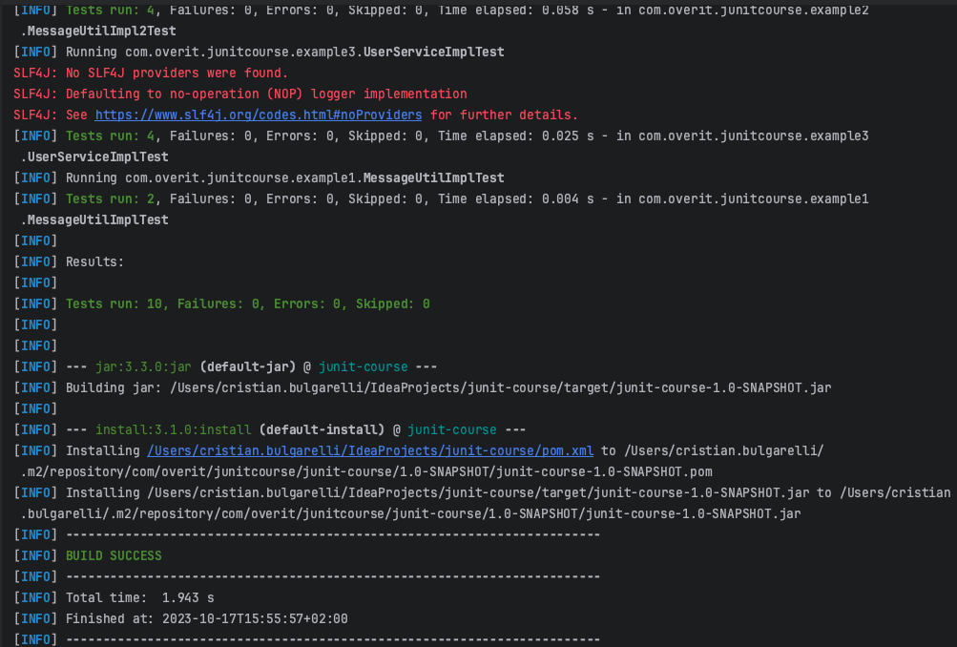
Here is an example of a test compilation launched from IntelliJ and completed successfully:
Cristian Bulgarelli - the source code is available at https://overit-factory@dev.azure.com/overit-factory/academy/_git/junitcourse

Slide 19
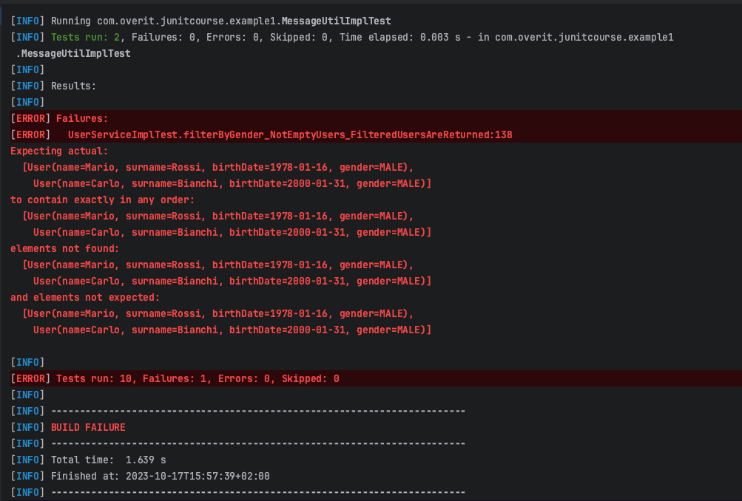
Here is another example of a test compilation launched from IntelliJ and failed:
Cristian Bulgarelli - the source code is available at https://overit-factory@dev.azure.com/overit-factory/academy/_git/junitcourse

Slide 20
6. Easy-random (https://github.com/j-easy/easy-random)
The Easy-random dependency has been widely used, it is a library that generates random Java objects. Let's say you have a class Person and you want to generate a random instance of it, here we go:
EasyRandom easyRandom = new EasyRandom();
Person person = easyRandom.nextObject(Person.class);
Pom.xml dependency:
<dependency>
<groupId>org.jeasy</groupId>
<artifactId>easy-random-core</artifactId>
<version>5.0.0</version>
<scope>test</scope>
</dependency>
Cristian Bulgarelli - the source code is available at https://overit-factory@dev.azure.com/overit-factory/academy/_git/junitcourse

Slide 21
Here are some example of randomly generated objects:
EasyRandom easyRandom = new EasyRandom();
Person person = easyRandom.nextObject(Person.class);
String name = easyRandom.nextObject(String.class);
Integer age = easyRandom.nextInt();
Boolean valid = easyRandom.nextBoolean();
Company company = easyRandom.nextObject(Company.class);
User user = easyRandom.nextObject(User.class);
Cristian Bulgarelli - the source code is available at https://overit-factory@dev.azure.com/overit-factory/academy/_git/junitcourse

Slide 22
The EasyRandomParameters class is the main entry point to configure EasyRandom instances. It allows you to set all parameters to control how random data is generated:
EasyRandomParameters parameters = new EasyRandomParameters()
.seed(123L) // EasyRandom can be configured with a seed in order to generate the same random instances
.objectPoolSize(100) // When a type declares a field of the same type, Easy Random will not be able to generate a random object graph due to infinite recursion
.randomizationDepth(3) // The randomizationDepth allows you to limit the randomization depth in an object graph
.charset(forName("UTF-8")) // You can use the charset parameter to generate random values from the specified Charset in all character-based fields
.timeRange(nine, five) // You can use the dateRange and timeRange parameters to generate Date and Time values in a given range
.dateRange(today, tomorrow) // You can use the dateRange and timeRange parameters to generate Date and Time values in a given range
.stringLengthRange(5, 50) // Setting the stringLengthRange parameter tells Easy Random to generate random strings with a bounded size.
.collectionSizeRange(1, 10) // The collectionSizeRange parameter lets you bound the generated collections size
.scanClasspathForConcreteTypes(true) // This parameter tells Easy Random to scan the classpath and look for a concrete type of the abstract/interface field
.overrideDefaultInitialization(false). // To override the default initialization of generated random bean fields
.ignoreRandomizationErrors(true); // With this parameter set, any exception raised during the randomization process will be silently ignored
EasyRandom easyRandom = new EasyRandom(parameters);
Defaults are OK in most of the cases.
Cristian Bulgarelli - the source code is available at https://overit-factory@dev.azure.com/overit-factory/academy/_git/junitcourse

Slide 23
7. Mockito (https://site.mockito.org/)
Mockito is a library that allows you to act on all the external dependencies of the class under test, simulating their functioning and making assertions about them.
This prevents a failure of an external dependency from affecting the outcome of the class under test.
In order to use this dependency, you will need to integrate it as follows within your project's pom.xml:
<dependency>
<groupId>org.mockito</groupId>
<artifactId>mockito-core</artifactId>
<version>5.6.0</version>
<scope>test</scope>
</dependency>
<dependency>
<groupId>org.mockito</groupId>
<artifactId>mockito-junit-jupiter</artifactId>
<version> 5.6.0 </version>
<scope>test</scope>
</dependency>
Cristian Bulgarelli - the source code is available at https://overit-factory@dev.azure.com/overit-factory/academy/_git/junitcourse

Slide 24
Suppose we have the following class to test:
package com.overit.junitcourse.example4;
import com.overit.junitcourse.example3.User;
import java.util.List;
public interface NewsletterSendingService {
boolean sendNewsletterToMen(List<User> recipients, String subject, String body) throws NewsletterSendingException;
}
Cristian Bulgarelli - the source code is available at https://overit-factory@dev.azure.com/overit-factory/academy/_git/junitcourse

Slide 25
package com.overit.junitcourse.example4;
…
public class NewsletterSendingServiceImpl implements NewsletterSendingService {
…
private final UserService userService;
private final EmailSendingService emailSendingService;
private final EmailValidator emailValidator;
@Override
public boolean sendNewsletterToMen(@NonNull List<User> recipients, @NonNull String subject, @NonNull String body) throws NewsletterSendingException {
boolean[] result = {true};
// I only keep men from the list provided
List<User> menRecipients = userService.filterByGender(Gender.MALE, recipients);
menRecipients.forEach(recipient -> validateEmail(recipient.getEmail()));
menRecipients.forEach(recipient -> result[0] &= emailSendingService.sendEmail(SENDER_EMAIL, recipient.getEmail(), subject, body));
return result[0];
}
}
Cristian Bulgarelli - the source code is available at https://overit-factory@dev.azure.com/overit-factory/academy/_git/junitcourse

Slide 26
This class depends on three services on which it delegates: UserService, EmailSendingService, EmailValidator.
We would therefore need, when writing NewsletterSendingServiceImplTest, to use Mockito to mock the behavior of the services mentioned.
1. Setup
2. Mock dependencies
@ExtendWith(MockitoExtension.class)
class NewsletterSendingServiceImplTest {
}
@Mock
private UserService userService;
@Mock
private EmailSendingService emailSendingService;
@Mock
private EmailValidator emailValidator;
3. Init SUT
@InjectMocks
private NewsletterSendingServiceImpl sut;
@BeforeEach
void setup() {
sut = new NewsletterSendingServiceImpl(userService, emailSendingService, emailValidator);
}
or
Cristian Bulgarelli - the source code is available at https://overit-factory@dev.azure.com/overit-factory/academy/_git/junitcourse

Slide 27
Here are some example of using mocks:
Mockito.when(mock.someMethod(10)).thenReturn(true); // when mock.someMethod(10) is invoked, return true
Mockito.when(mock.someMethod(10)).thenThrow(new RuntimeException()); // when mock.someMethod(10) is invoked, throw a RuntimeException
Mockito.doNothing().when(mock).someMethod(); // void method does nothing when invoked
Mockito.doThrow(new RuntimeException()).when(mock).someMethod(); // void method throws a RuntimeException when invoked
Mocks can be created with precise values or with argument matchers, to make them respond to multiple combinations of input values. Let's see some examples:
when(userService.filterByGender(any(Gender.class), anyList())).thenThrow(new Exception()); //mock invoked with with any value of Gender
// and any list of User
doNothing().when(spiedSut).validateEmail(anyString()); // do nothing when validateEmail(…) is invoked with any string
It is important to remember that, when defining mocks, it is possible to mock a method with only specific arguments or with only argument matchers, mixed use is not allowed.
So the following code, which uses both specific values and argument matchers, is invalid:
when(userService.filterByGender(Gender.MALE, anyList())).thenThrow(expectedException); // INVALID!
For more information on argument matchers see https://site.mockito.org/javadoc/current/org/mockito/ArgumentMatchers.html
Cristian Bulgarelli - the source code is available at https://overit-factory@dev.azure.com/overit-factory/academy/_git/junitcourse

Slide 28
Mockito not only offers the possibility of mocking the behavior of methods, but also the possibility of making assertions about whether or not these methods have been called, how many times and with which arguments.
verify(userService).filterByGender(Gender.MALE, recipients);
Below are other examples of using verify(…):
verify(userService).filterByGender(Gender.MALE, recipients); // method filterByGender(…) called once, with the values Gender.MALE and recipients
verify(userService, times(3)).filterByGender(Gender.MALE, recipients); // method filterByGender(…) called three times, with the values Gender.MALE and recipients
verify(userService, atLeastOnce()).filterByGender(Gender.MALE, recipients); // method filterByGender(…) called at least once, with the values Gender.MALE and recipients
verify(userService, never()).filterByGender(any(Gender.class), anyList()); // method filterByGender(…) never called, with any value
For more information on argument matchers see https://javadoc.io/doc/org.mockito/mockito-core/latest/org/mockito/Mockito.html#1
Cristian Bulgarelli - the source code is available at https://overit-factory@dev.azure.com/overit-factory/academy/_git/junitcourse

Slide 29
Mockito – mocking static methods
It is also possible to define mocks on static methods, although slightly more complicated. An instance of org.mockito.MockedStatic is created, via the org.mockito.Mockito#mockStatic(java.lang.Class<T>) method, typically within a try-with-resources block.
Here is an example of how to mock the static Gender.of(String) method:
try (MockedStatic<Gender> mockedGender = mockStatic(Gender.class)) { // static mock creation
mockedGender.when(() -> Gender.of(genderAsString)).thenReturn(gender); // mocking static method call
// when
sut.gender(genderAsString);
User actual = sut.build();
// then
assertThat(actual).isNotNull()
.usingRecursiveComparison()
.isEqualTo(expected);
mockedGender.verify(() -> Gender.of(genderAsString)); // assertion on static method call
}
Cristian Bulgarelli - the source code is available at https://overit-factory@dev.azure.com/overit-factory/academy/_git/junitcourse

Slide 30
Mockito Spy
A Mockito Spy can be created via the org.mockito.Mockito#spy(T) method or the org.mockito.Spy annotation.
Once the spy has been created, calls to its methods will execute the real methods, unless they have previously been mocked using the pattern already seen.
Below is an example of creating a spy object:
@Spy
@InjectMocks
private NewsletterSendingServiceImpl spiedSut;
@Mock
private UserService userService;
@Mock
private EmailSendingService emailSendingService;
@Mock
private EmailValidator emailValidator;
or
@BeforeEach
void setup() {
spiedSut = Mockito.spy(new NewsletterSendingServiceImpl(userService, emailSendingService, emailValidator));
}
Cristian Bulgarelli - the source code is available at https://overit-factory@dev.azure.com/overit-factory/academy/_git/junitcourse

Slide 31
Important gotcha on spying real objects!
Sometimes it's impossible or impractical to use Mockito.when(Object) for stubbing spies. Therefore for spies it is recommended to always use doReturn|Answer|Throw()|CallRealMethod family of methods for stubbing.
Example:
List list = new LinkedList();
List spy = spy(list);
// Impossible: real method is called so spy.get(0) throws IndexOutOfBoundsException (the list is yet empty)
when(spy.get(0)).thenReturn("foo");
// You have to use doReturn() for stubbing
doReturn("foo").when(spy).get(0);
Cristian Bulgarelli - the source code is available at https://overit-factory@dev.azure.com/overit-factory/academy/_git/junitcourse

Slide 32
Below is an example of a test that uses the Mockito Spy mechanism. The sendNewsletterToMen(...) method under test internally calls the validateEmail(String) method. This last method is spied on to mock its behavior.
@Test
void sendNewsletterToMen_ValidateEmailThrowsInvalidEmailException_ANewsletterSendingExceptionIsThrown() {
// given
…
doThrow(expectedException).when(spiedSut).validateEmail(menRecipients.get(0).getEmail()); // the spied method validateEmail(…) is mocked
// when
assertThatThrownBy(() -> spiedSut.sendNewsletterToMen(recipients, subject, body)) // the method sendNewsletterToMen(..) has not been mocked
.isInstanceOf(NewsletterSendingException.class)
.hasMessage(INVALID_E_MAIL_FOUND)
.hasRootCause(expectedException);
// then
verify(spiedSut).validateEmail(menRecipients.get(0).getEmail()); // assertion on spied mocked method
…
}
Cristian Bulgarelli - the source code is available at https://overit-factory@dev.azure.com/overit-factory/academy/_git/junitcourse

Slide 33

Thank You.

